Slide 1

DESIGN PHASE
ORIGIN LAB
(DIAGNOSTIC LABORATORY SYSTEM)
Kyrshanlang R. Dkhar
MCA 5th Semester
Roll No: SACMC 15/01
Guide: Ma’am Medari Tham

Slide 2
Contents
Introduction
Module Design
Menu Design
Database Design
Input-Output Design

Slide 3
Introduction
The Organization has departments and each department has several tests.
Each Test is different for each department, test are specific and performed normally with three different methods, therefore they are divided into three types(NORMAL,CULTURE AND SPECIAL) of Tests.
The Organization also tracks Patients, Patient’s Test Results and The Normal Ranges of the Normal Tests.
The Administrator takes care of Departments, Tests and Patients.
The Lab Technician Performs Test.

Slide 4
Module Design
Weighbridge S/W
Slip Generator*
Previous Slip Printer
Flexi-Report Generator
CRUD : Products, Suppliers, Vehicles
S/W Configuration & Setup

Slide 5
Module Design
Main Dashboard Module
Slip Generator* Module
Previous Slip Printer Module
Flexi-Report Generator Module
CRUD : Products, Suppliers, Vehicles Module
S/W Configuration & Setup Module

Slide 6
Module Design
Main Dashboard Module
  This Module is the main module that the user sees when logged in.
  This Module Provides the user with options to interact with the different modules
  It also provide a short Over view of the System; i.e Number of Products, Slips Generated for the Month, Vehicles, Reports

Slide 7
Module Design
Department And Test Management Module
  This Module can be further divided into two smaller modules in which the administrator of the system can manage the departments in the system and the test that each department performs.
  The Department Module allows the admin to view, create, edit and remove departments.
  The Test Module allows the admin to view, create, edit and remove tests of each department.

Slide 8
Module Design
Patient Module
  This Module allows the user of the system to view a patient’s details, add a new patient, edit a patient and remove an existing patient.
  It can also allow the user to find/search for an existing patient.

Slide 9
Module Design
Patient’s Test Report and Bill Generator Module
  This Module allows the user to generate Test Report on the various tests performed by the laboratory for a patient. It will generate the bill of the Test Report and also allow the user of the system to Print the Report and The Bill of a particular patient.
  Additional features of this module is that test results will be validated during the master entry by the user into the system, and only values that are confirmed will be stored, any abnormal value will be notified to the user.

Slide 10
Module Design
Monthly Report Generator Module
  This Module will be called by the main module and its purpose is to generate monthly reports on the Total Number of Tests done, Total Number of Positive Test cases and Total Number of new Patients in the month.
  The output of this module will be on displayed in two charts one for The Test and another for the Patients.

Slide 11
Module Design
Normal Range Standardization Module
  This Module will make the workflow of finding and calculating the Standard Normal Range of a particular Test after a period of six months or more and it will provide the user with the average normal range, highest and lowest result value of a particular test.
  These new standard normal range can then be updated to the existing normal range.

Slide 12
Menu Design
Weighment–
  Generate Slip
  Duplicate Slip
  Report Generator
Test –
  View Tests of a Department
  Create A New Test
  Edit A Test
  Remove A Test

Slide 13
Menu Design
Perform Test
Patient –
  View All Patients
  Find An Existing Patient
  Add A New Patient
  Edit Patient Details
  Remove Patient Detail
Reports –
  View All Reports
  Print A Report
  Remove A Report

Slide 14
Menu Design
Standardize Normal Range
  Find the new Standard normal range of a Test
  View the new Standard normal range of a Test
Bills –
  View All Bills
  Print A Bill of a Particular Report
  Remove A Bill

Slide 15
Database Design
ER DIAGRAM
DATABASE SCHEMA
DATABASE TABLES

Slide 16
ER DIAGRAM
ER2.pdf

Slide 17
DATABASE SCHEMA
SCHEMA.pdf

Slide 18
DATABASE TABLES
PATIENT TABLE
TEST TABLE
NAME | DATATYPE | CONSTRAINTS | Description
Patient ID | INTEGER | PRIMARY KEY | Unique if of Patient
First_Name | VARCHAR(20) | NOT NULL | Name of the Patient
Last_Name | VARCHAR(20) | NOT NULL | Name of the Patient
Gender | VARCHAR(10) | NOT NULL | Gender of the Patient
DOB | INTEGER | NOT NULL | Date of Birth of the Patient

Slide 19
DATABASE TABLES
DEPARTMENT TABLE
TEST TABLE
NAME | DATATYPE | CONSTRAINTS | Description
Department_ID | INTEGER | PRIMARY KEY | Unique Id for Department
Department_Name | VARCHAR(50) | UNIQUE | Name of the Department
Manager_ID | INTEGER | FOREIGN KEY | ID of Manager
NAME | DATATYPE | CONSTRAINTS | Description
Test_ID | INTEGER | PRIMARY KEY | Unique Id
Test Name | VARCHAR(20) | UNIQUE | Name of the Test
Department_ID | INTEGER | FOREIGN KEY | Id of the Department
Rate | INTEGER | NOT NULL | Cost of the Test

Slide 20
DATABASE TABLES
NORMAL _TEST TABLE
NAME | DATATYPE | CONSTRAINTS | Description
ID | INTEGER | PRIMARY KEY | Unique Id
Unit | VARCHAR(20) | NULL | Unit of measurement of the Test
Lower_Bound | DECIMAL(3,3) | NOT NULL | Lower bound value of the Test
Upper_Bound | DECIMAL(3,3) | NOT NULL | Upper bound value of the Test
Group_ID | INTEGER | FOREIGN KEY | Id of Test_Group
Test_ID | INTEGER | FOREIGN KEY | Id of Test

Slide 21
DATABASE TABLES
CULTURE_TEST TABLE
SPECIAL_TEST TABLE
NAME | DATATYPE | CONSTRAINTS | Description
ID | INTEGER | PRIMARY KEY | Unique Id
Specimen | VARCHAR(50) | NOT NULL | Name of the Specimen
Test_ID | INTEGER | FOREIGN KEY | Id of Test
NAME | DATATYPE | CONSTRAINTS | Description
ID | INTEGER | PRIMARY KEY | Unique Id
Test_Parameter_No | INTEGER | NOT NULL | The Input
Test_Parameter_Title | VARCHAR(20) | NOT NULL | Heading of the input
Test_ID | INTEGER | FOREIGN KEY | Id of Test

Slide 22
DATABASE TABLES
TEST_GROUP TABLE
NORMAL_TEST_RESULT TABLE
NAME | DATATYPE | CONSTRAINTS | Description
ID | INTEGER | PRIMARY KEY | Unique Id
Name | VARCHAR(50) | NOT NULL | Name of the Test Group
NAME | DATATYPE | CONSTRAINTS | Description
ID | INTEGER | PRIMARY KEY | Unique Id
Result | DECIMAL(3,3) | NOT NULL | The Result
Info | VARCHAR(10) | NOT NULL | Short Information on the Test
Test_ID | INTEGER | FOREIGN KEY | Id of Test
Report_ID | INTEGER | FOREIGN_KEY | Id of Report

Slide 23
DATABASE TABLES
CULTURE_TEST_RESULT TABLE
NAME | DATATYPE | CONSTRAINTS | Description
ID | INTEGER | PRIMARY KEY | Unique Id
Organism | VARCHAR(50) | NOT NULL | Name of the Organism
Antibiotic | VARCHAR(50) | NOT NULL | Name of Antibiotic
Inference | VARCHAR(20) | NOT NULL | Sensitivity of The Specimen
Test_ID | INTEGER | FOREIGN KEY | Id of Test
Report_ID | INTEGER | FOREIGN_KEY | Id of Report

Slide 24
DATABASE TABLES
SPECIAL_TEST_RESULT
NAME | DATATYPE | CONSTRAINTS | Description
ID | INTEGER | PRIMARY KEY | Unique Id
Result | VARCHAR(50) | NOT NULL | Name of the Specimen
Test_ID | INTEGER | FOREIGN KEY | Id of Test
Report_ID | INTEGER | FOREIGN KEY | Id of Report

Slide 25
REPORT_OF_PATIENT_TAKES_TEST TABLE
NAME | DATATYPE | CONSTRAINTS | Description
Report_ID | INTEGER | PRIMARY KEY | Unique Id
Date_done | DATE | NOT NULL | DATE when Report was Generated
Cost | DECIMAL(6,2) | NOT NULL | Total Cost of the Test Performed
Paid_Status | VARCHAR(10) | NOT NULL | Status Whether
Comments | TEXT | NULL | Comments on the Report
Done_by | INTEGER | FOREIGN KEY | Tells us that the Report was Generated by a Staff (STAFF-ID)
Patient_ID | INTEGER | FOREIGN KEY | Id of Patient

Slide 26
DATABASE TABLES
USER TABLE
NAME | DATATYPE | CONSTRAINTS | Description
ID | INTEGER | PRIMARY KEY | Unique Id
Username | VARCHAR(50) | UNIQUE | Username of the user
Password | VARCHAR(250) | NOT NULL | Stores the Hash Password of the user
Role | VARCHAR(20) | NOT NULL | Role of The user

Slide 27
DATABASE TABLES
STAFF TABLE
NAME | DATATYPE | CONSTRAINTS | Description
User_id | INTEGER | FOREIGN KEY | Id of the user
First Name | VARCHAR(50) | NOT NULL | Name of the Staff
Last Name | VARCHAR(50) | NOT NULL | Name of The Staff
Designation | VARCHAR(20) | NOT NULL | Designation of The Staff

Slide 28
DATABASE TABLES
STANDARD_NORMAL_RANGE TABLE
NAME | DATATYPE | CONSTRAINTS | Description
ID | INTEGER | PRIMARY KEY | Unique Id
AVERAGE_LOWER_BOUND | DECIMAL(3,3) | NOT NULL | LOWER BOUND OF TEST
AVERAGE_UPPER_BOUND | DECIMAL(3,3) | NOT NULL | UPPER BOUND OF TEST
MIN_LOWER_BOUND | DECIMAL(3,3) | NOT NULL | Minimum Lower Bound of Test
MAX_UPPER_BOUND | DECIMAL(3,3) | NOT NULL | Maximum Upper Bound of Test
DATE_CALCULATED | DAE | NOT NULL | Date of Standardization
Test_ID | INTEGER | FOREIGN KEY | Id of Test

Slide 29
Input-Output Design
The Interface for the mini project will be build on the Bootstrap CSS framework and based on the free paper-dashboard theme by Creative Tim.
Bootstrap is an open source toolkit for developing with HTML, CSS, and JS. It is a framework for building responsive, mobile-first sites.

Slide 30
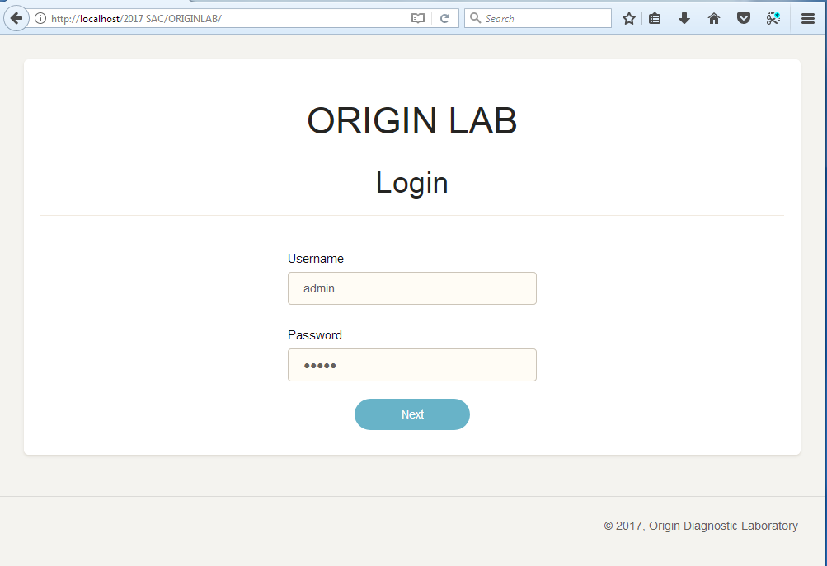

Slide 31
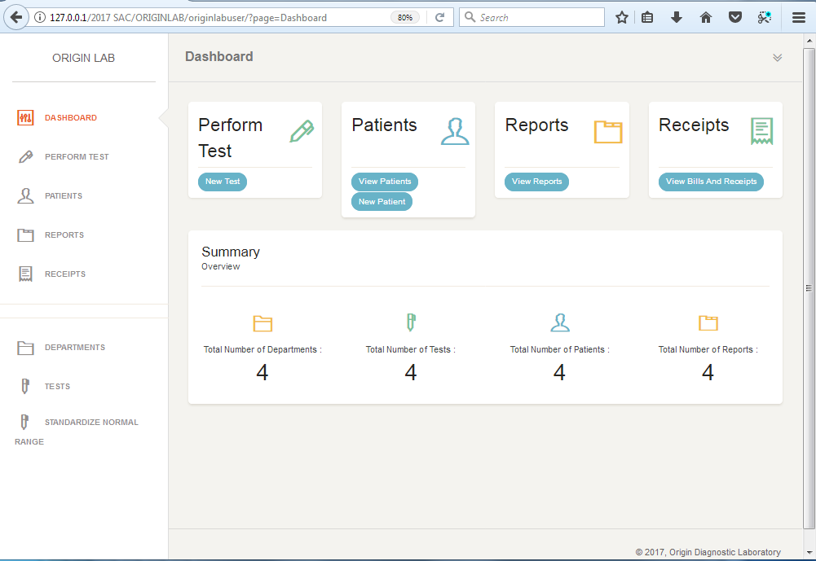


Slide 32
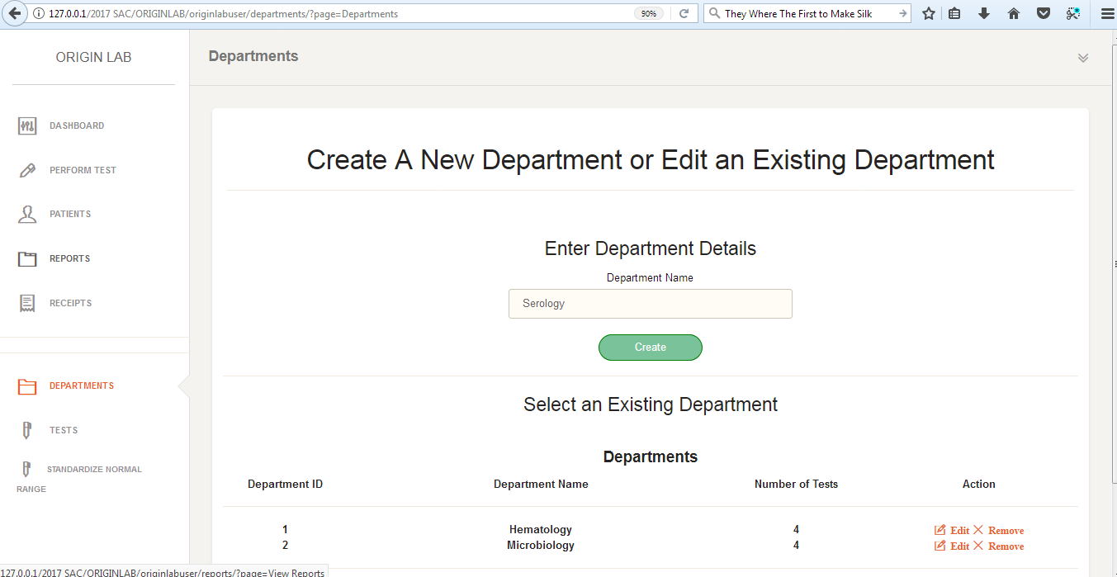

Slide 33
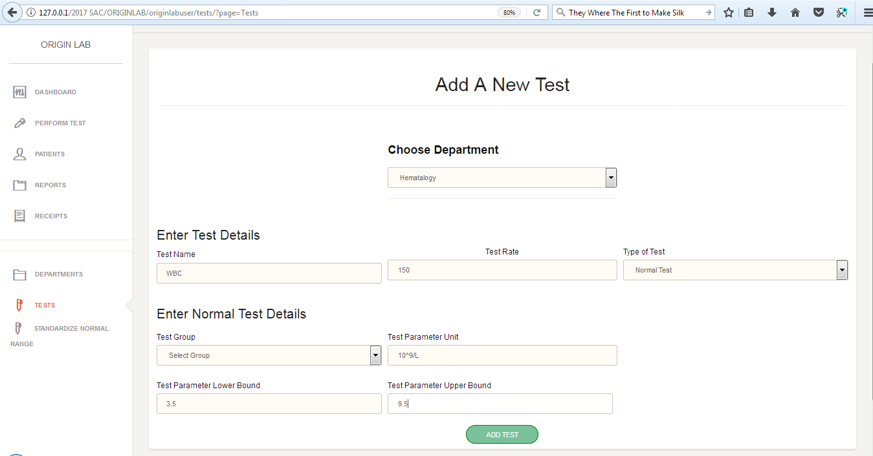

Slide 34
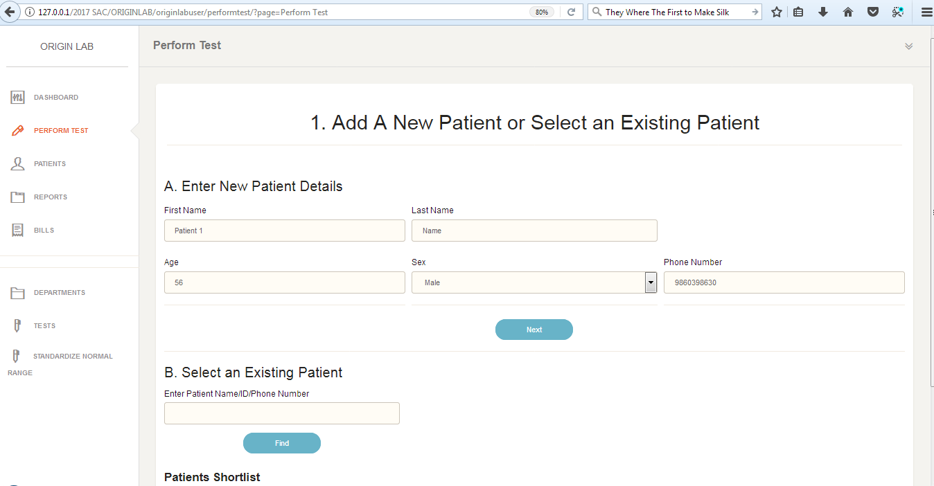
Date of Birth
17/01/1994

Slide 35
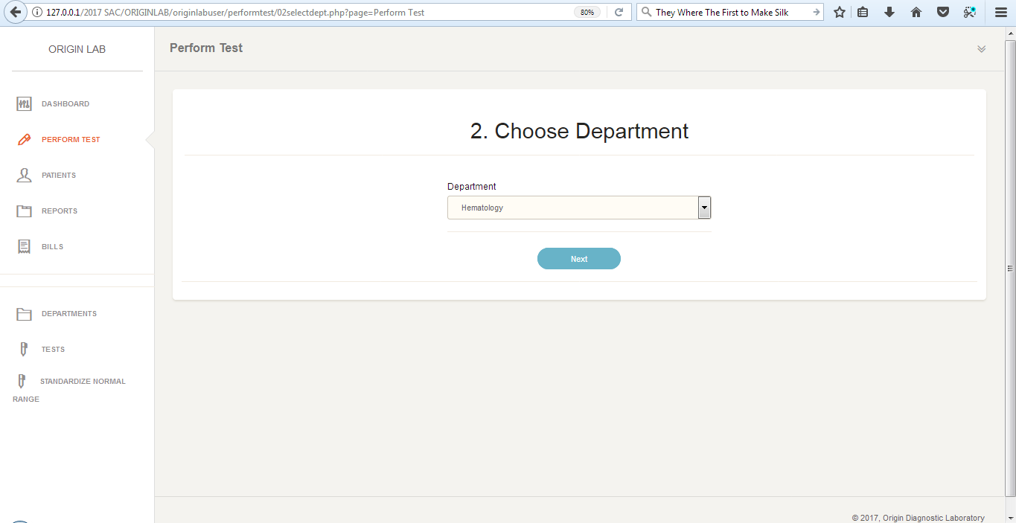

Slide 36
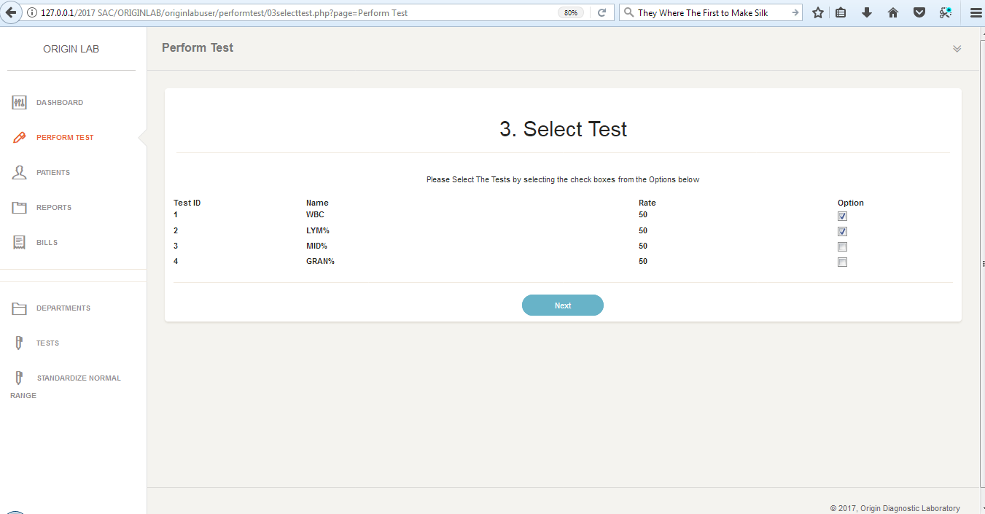

Slide 37
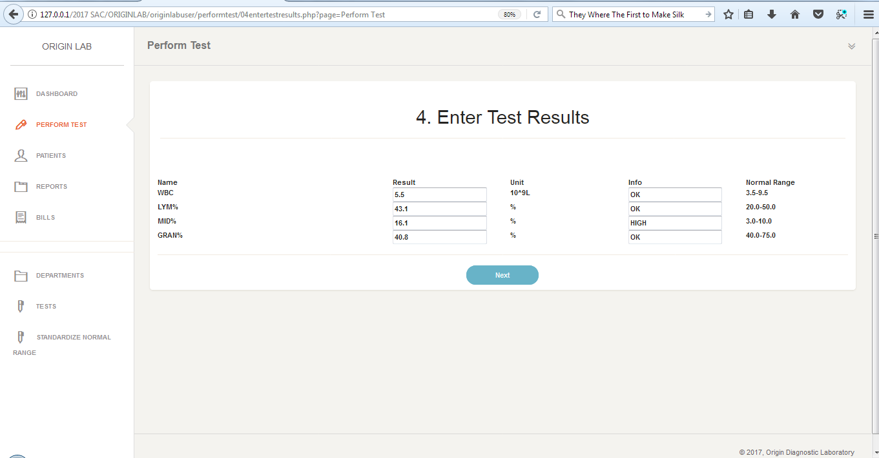

Slide 38
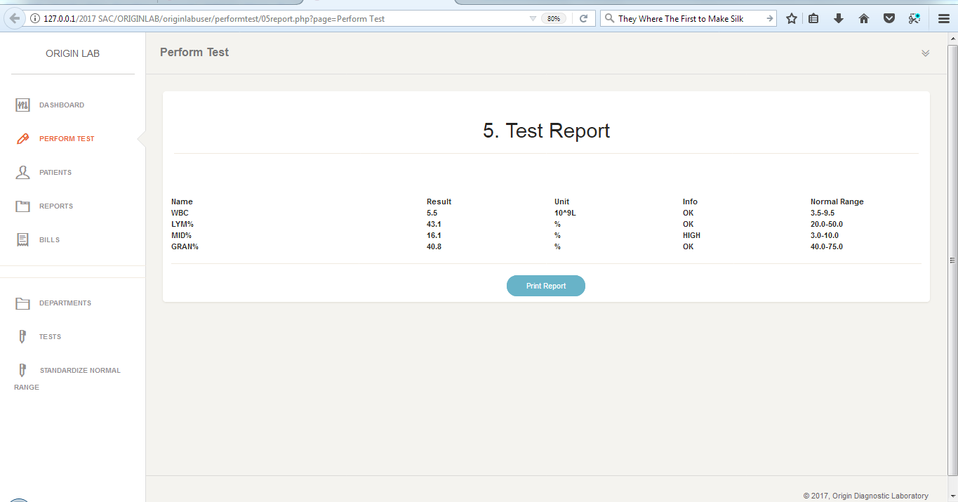

Slide 39
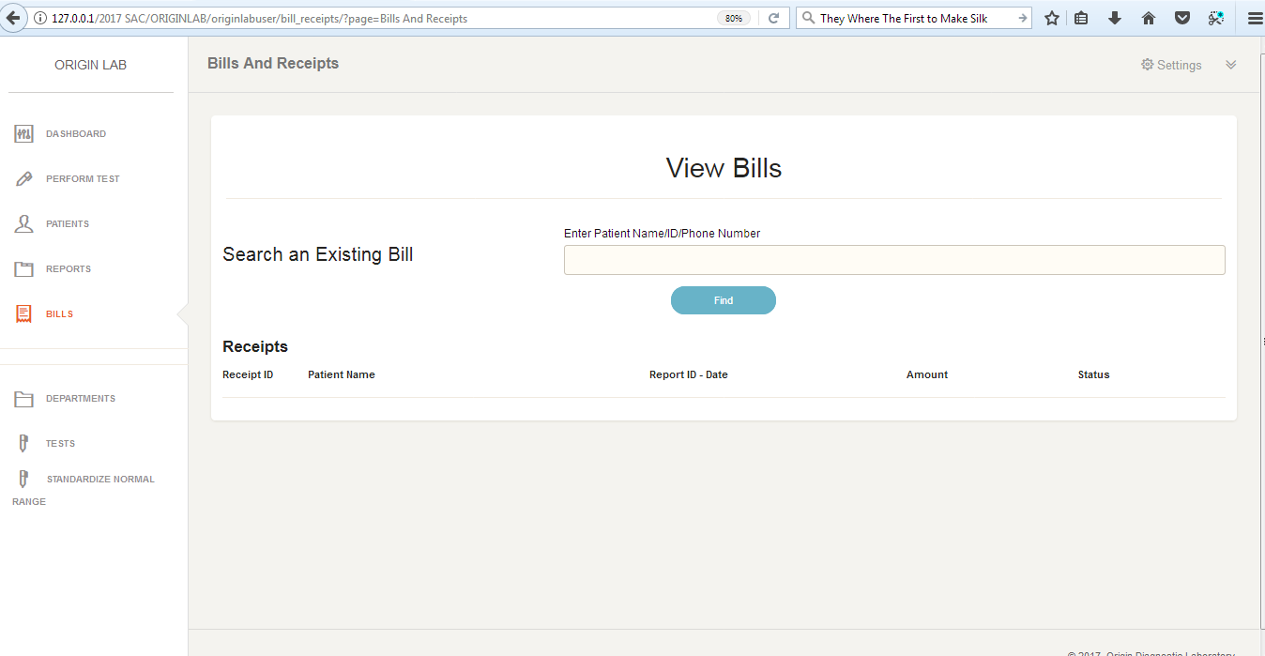

Slide 40
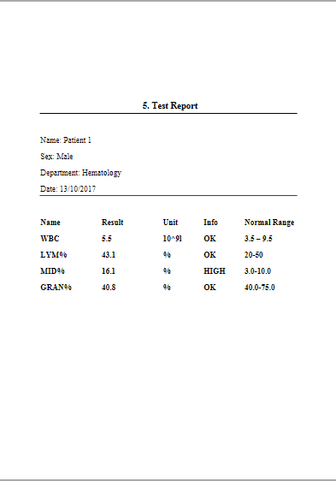

Slide 41
THANK YOU

